Slide 1

Final Presentation
Hot Shots
Reddit Flask Application
By: Saud, Gabriel, Manuel
Software System Capstone Project SP24-CPSE-49200-005

Slide 2
Introduction
Conducted extensive research and planning to identify project objectives and requirements.
Developed and implemented a comprehensive project plan, outlining tasks, timelines, and responsibilities.
What We Accomplished: Successfully created a robust backend infrastructure using Python Flask and SQLAlchemy.
Designed an intuitive frontend interface with essential features like posting, commenting, and resource access.
Purpose: Aimed to address communication deficiencies within the university community.
Strived to create a centralized digital space for seamless interaction, information sharing, and collaboration.

Slide 3


Purpose
Improved Communication: The Lewis University Reddit-style platform enhances communication and collaboration within the university community.
It Serves as a centralized digital space, the platform enables easy interaction, idea sharing, and access to important information for students, faculty, and staff.
Its user-friendly design breaks down communication barriers, fostering inclusivity and community engagement.
With features such as posting, commenting, and resource access, the platform encourages active participation and knowledge sharing among users.

Slide 4
Roles and responsibilities
Saud | Gabriel | Manuel
Developing Backend Database Presentations | Creating Wireframes Handling GitHub Project Manual PowerPoint | Frontend Testing Progress Documents

Slide 5
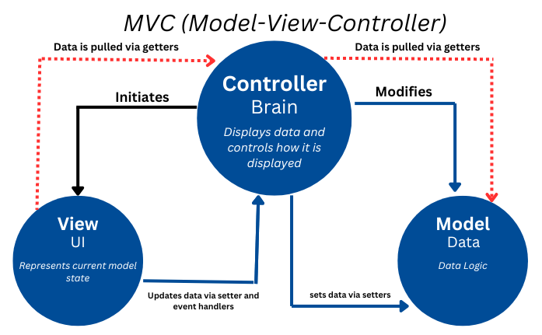
Reddit architecture

Slide 6
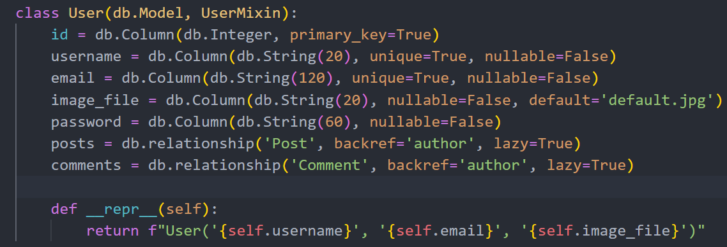
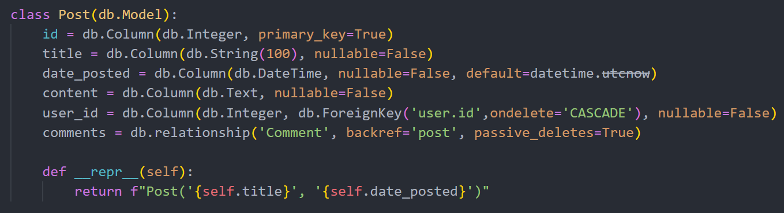
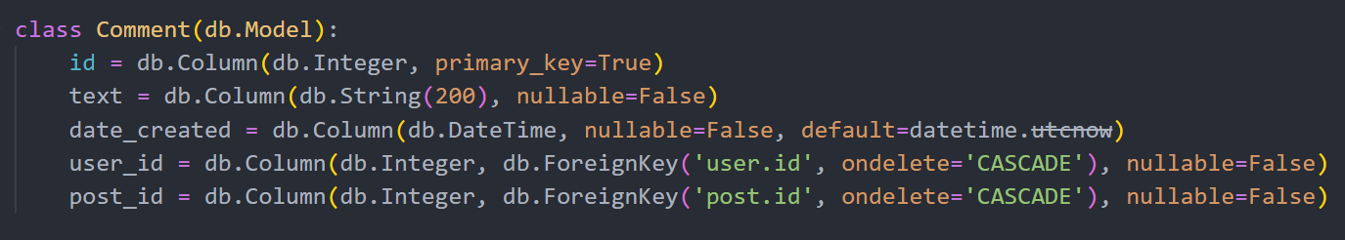
database
We have three models: User, Post, and Comment
User Model Management
Post Model Centralization
Comment Model Interaction

Slide 7
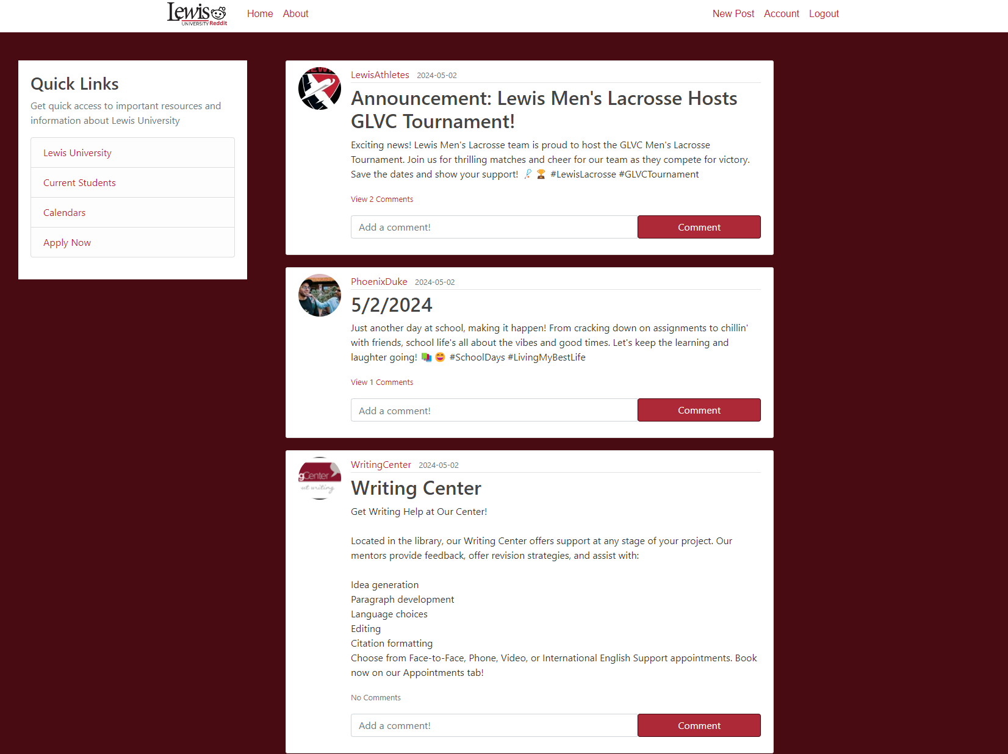
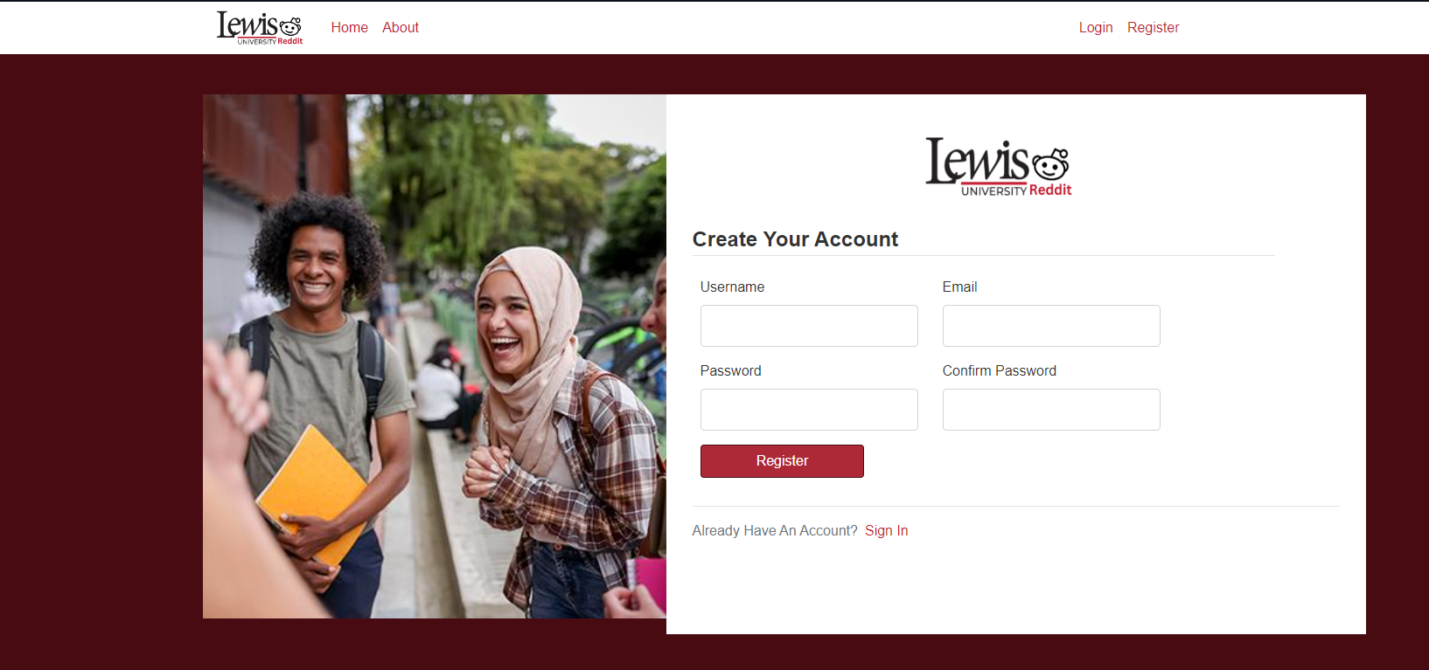
FRONTEND

Slide 8
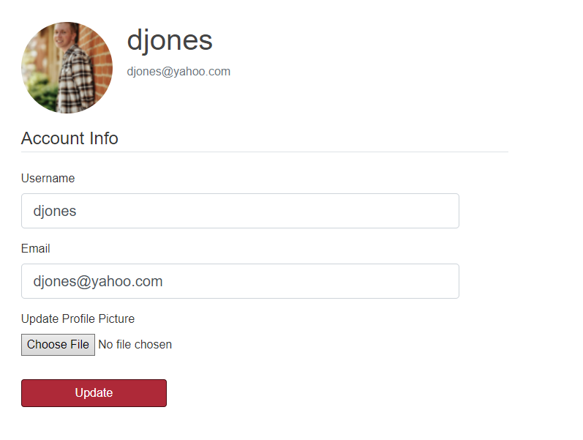
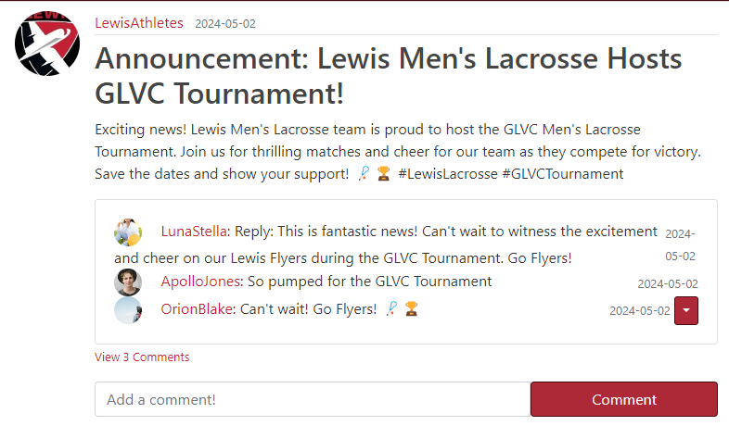
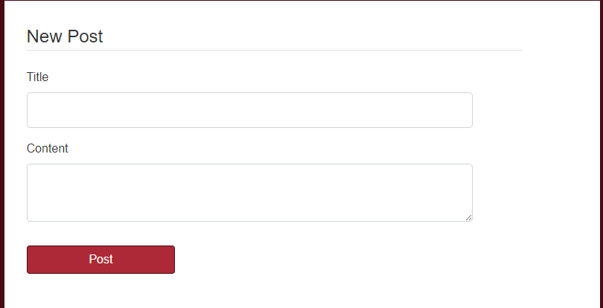
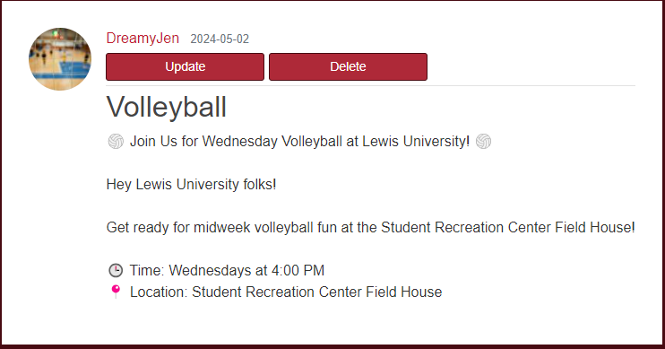
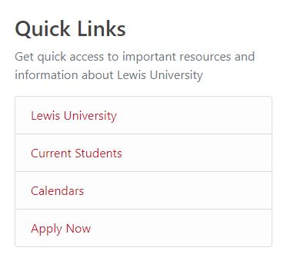
Features
Post
Comment
Update
Delete
Sidebar
Account

Slide 9
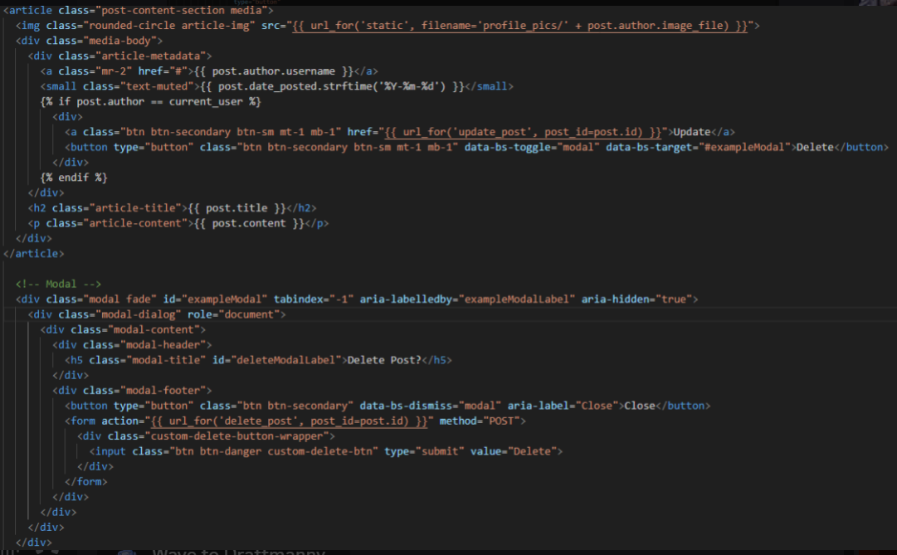
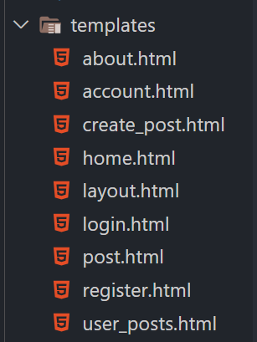
Logic and snippets

Slide 10
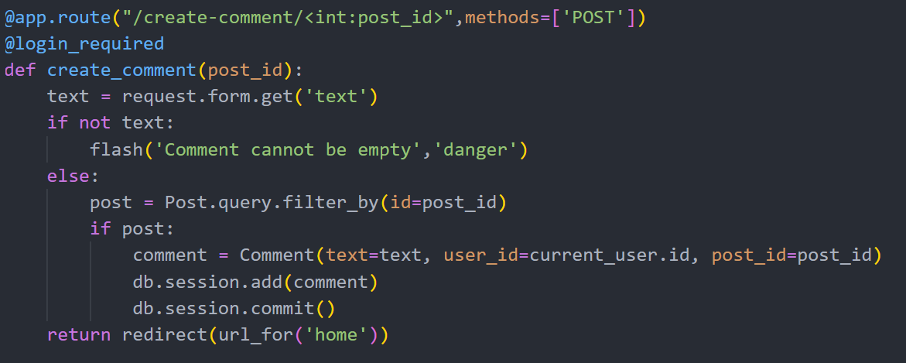
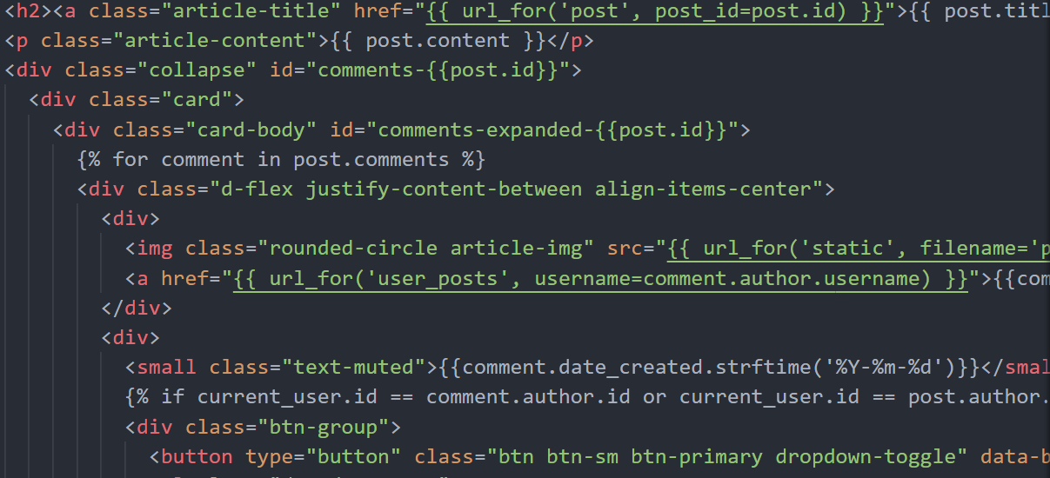
Backend and how we incorporate into our website
Brainstorming Logic
Used Jinjas to use python scripts

Slide 11
List of controllers/functionalities
/home: Renders home page with posts ordered by date posted.
/about: Renders about page.
/register: Handles user registration with form validation.
/login: Handles user login with form validation.
/logout: Logs out the current user.
/account: Renders user account page with form for updating user information and profile picture.
/post/new: Allows authenticated users to create new posts with form validation.
/post/<post_id>: Renders individual post based on post_id.
/post/<post_id>/update: Allows post author to update post content with form validation.
/post/<post_id>/delete: Allows post author to delete a post.
/create-comment/<post_id>: Handles creation of comments on posts with form validation.
/delete-comment/<comment_id>: Allows comment author or post author to delete comments.
/user/<username>: Renders posts by a specific user.

Slide 12


Keytakes
Collaborative Skills Development
Enhanced Communication Abilities
Diverse Perspectives and Ideas
Time Management and Accountability
Conflict Resolution and Adaptability
Leadership and Followership Skills
Reflection and Continuous Improvement
. Embracing a culture of continuous learning and feedback

Slide 13
Development & Management Tools
GitHub Link: https://github.com/saudahmed022/lewis-university-capstone
GitHub hosts Git repositories in the cloud, providing a centralized location for storing and managing code. This allows developers to access their code from anywhere and ensures that their work is backed up and secure.

Slide 14


Thank you & Any question

